Slide 1
Mississippi Home Corporation Mississippi Development Authority
2021 Annual Action Plan

Slide 2
PUBLIC HEARING MEETING
OVERVIEW

Slide 3
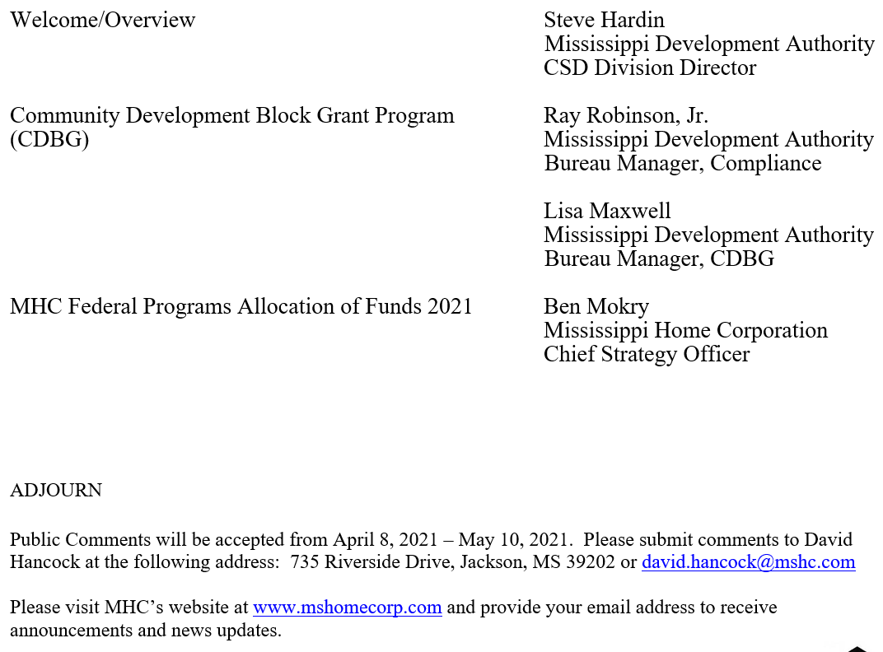

Slide 4
Purpose of Public Review Meetings:
Gather public input on the Allocation of expected Federal Program Funding for 2021.
Gather public input on the production of housing units and services from 2020.
Explain how to provide written comments on actions proposed to be taken by MHC and MDA

Slide 5
MHC Federal Programs
Process:
The 2021 Annual Action Plan will be submitted to HUD by May 15, 2021. One (1) public input meeting is scheduled to be held virtually statewide on Tuesday, April 6, 2021.
A public comment period will be held April 8, 2021 – May 10, 2021. Comments received will be considered for incorporation in the Annual Action Plan by Mississippi Home Corporation (MHC) for HOME, ESG, HOPWA, and HTF programs and Mississippi Development Authority (MDA) for the Community Development Block Grant program (CDBG).

Slide 6
Activities
The following programs will be identified in the 2021 Annual Action Plan.
Emergency Solutions Grant Program (ESG)
HOME Investment Partnerships Program (HOME)
Homeowner Rehabilitation
Homeowner Rehabilitation Disaster
Rental
Home Buyer Assistance
Community Housing Development Organization (CHDO)
Housing Opportunity for Persons with AIDS (HOPWA)
National Housing Trust Fund (HTF)

Slide 7
Emergency Solutions Grant Program (ESG)
ESG Program is designed to improve administrative efficiency and enhance response coordination and effectiveness in addressing the needs of homeless persons. Proposed program activities for 2021:
services for persons who are homeless, at risk of homelessness
services for special populations such as homeless youth, victim services (victims of human trafficking)
The five ESG program components are: street outreach, emergency shelter (homeless population, domestic violence and children and youth), rapid re-housing of homeless individuals and/or families, homeless prevention to individuals and/or families at risk of homelessness, and Homeless Management Information System (HMIS) data collection.

Slide 8
HOME Investment Partnerships Program (HOME)
HOME funds assist households with income at or below 80% of area median income according to family size and locale.

Slide 9
(HOME) - Homeowner Rehabilitation
Funds are used to provide safe, decent, affordable housing by eliminating substandard conditions, through rehabilitation or reconstruction of owner-occupied units. HOME funds are distributed through a competitive process.

Slide 10
(HOME) - Homeowner Rehabilitation Disaster
Funds are used to provide housing assistance to counties covered by an Emergency or Major Disaster Declaration issued by the Federal Emergency Management Agency (FEMA). Counties impacted by the disaster are eligible to apply. Eligible activities under this Program are repair, rehabilitation of single-family owner-occupied housing and rehabilitation, replacement of owner-occupied manufactured housing.

Slide 11
(HOME) - Rental
Funds will be used to provide rental housing for low to very low-income households. The Rental Housing Set-Aside funding will provide "gap" financing rental housing development activities, acquisition/rehab rental housing activities, or substantial rehabilitation of rental units. Eligible applicants are for profit and non-pro fit organizations with demonstrated experience and capacity to undertake HOME activities, according to HUD regulations. HOME funds are distributed through a competitive process and in the form of a cash flow loan.

Slide 12
(HOME) – Home Buyer Assistance
Home Buyer Assistance Set-Aside funds will be used to provide down-payment, principal reduction, and closing cost assistance to income eligible households to purchase a home. Thirty-three percent (33%) of funds will be dedicated to serving persons with disabilities. MHC expects to contract with one or more HUD-approved housing counseling agencies to identify eligible households, collect documentation required to determine eligibility for HOME funds, and work with buyer and lender through loan closing. MHC will make the final determination about the applicant’s eligibility and the amount of financial assistance to be allowed.

Slide 13
Community Housing Development Organization (CHDO)
CHDO Set-Aside/Rental Housing Set-Aside will provide development or substantial rehabilitation of multi-family rental units and development of single-family homeownership units by creating decent housing with improved availability. Funds will be allocated for CHDO operations.

Slide 14
Housing Opportunity for Persons with AIDS (HOPWA)
HOPWA funds provide services for low-income persons/families with HIV/AIDS to prevent homelessness. The proposed activities for 2021 are: Short-Term Rent, Mortgage and Utility assistance (STRMU), Tenant-Based Rental Assistance (TBRA), Short-Term Supported housing, Master Leasing, Permanent Housing Placement, housing information, supportive services, resource identification, acquisition, construction, or rehabilitation of structures used for eligible HOPWA activities, and technical assistance.

Slide 15
National Housing Trust Fund (HTF)
The primary purposes of the NHTF is to increase and preserve the supply of rental housing for extremely low- income households earning less than 30% of area median income (AMI) or the federal poverty guidelines published by the Department of Health and Human Services. The State is required to prepare a separate Annual Allocation Plan for HTF. It is submitted with the Annual Action Plan for other HUD Programs.

Slide 16
2020 (ESG)
Estimated Units and Individuals Assisted
ESG | 17 Projects awarded | Total= $2,280,468 | Avg/month
Shelter | 1237 |  | 103
Rapid Rehousing | 729 |  | 61
Homeless Prevention | 440 |  | 37
HOPWA | 2 Projects | $1,483,965 | Avg/month
Total unique clients | 399
STRMU | 67 |  | 6
TBRA | 188 |  | 188
PHP | 135 |  | 11
Master Leasing | 67 |  | 67

Slide 17
2020 (HOME) - Homeowner Rehab
Estimated Units and Individuals Assisted
Homeowner Rehabilitation 2020:
5 projects
Number of households/units: 38 units
Estimated beneficiaries: 76
Total Funded: $2,716,100
Reconstruction: 6 units- $807,900
Rehabilitation: 32 units-$1,908,200

Slide 18
2020 (CHDO)
Estimated Units and Individuals Assisted
2020 Allocation for CHDO: $1,537,918.80
2020 CHDO Activity for Homeownership: 0

Slide 19
2020 (HTF)
Estimated Units and Individuals Assisted
2020 HTF Rental Reservations
4 Developments-$3,420,091
2020 HOME Rental Reservations
4 Developments-$4,815,864
2020 HOME CHDO Rental
1 Development-$675,666

Slide 20
MHC Federal Programs
Proposed Allocation 2021
The proposed allocation of funds for 2021 are estimated based on the amount received in 2020 funding. Allocations to activities will be adjusted proportionately based on actual Federal Funds Received in 2021

Slide 21
Program | Activities | Proposed Allocation of Funds estimate based on amount received in 2020
ESG | Rapid Re-Housing | $359,344
 | Shelter | $715,616
 | Homeless Prevention | $659,187
 | Street Outreach | $382,952
 | HMIS* | $152,555
 | State Administration | $100,000
TOTAL ESG |  | $ 2,369,654
HOME | Homeowner Rehabilitation | $2,376,965
 | Rental | $3,800,548
 | Home Buyer Assistance | $1,000,000
 | CHDO Set-Aside | $1,500,000
 | CHDO Operating Expenses | $50,000
 | Disaster | $500,000
 | State Administration | $1,025,279
TOTAL HOME |  | $10,252,792

Slide 22
Program | Activities | Proposed Allocation of Funds estimate based on amount received in 2020
HOPWA | Substantial Rehab/New Construction | $500,000
 | Services | $1,171,519
TOTAL HOPWA |  | $1,671,519
HTF | Construction/Rehabilitation | $2,700,000
 | Admin | $300,000
TOTAL HTF |  | $3,000,000

Slide 23
Public comments
Draft Plan Availability
April 8, 2021
Public Comment Period
April 8, 2021-May 10, 2021
Public Comments should be submitted to:
Mississippi Home Corporation
Jackson, MS 39202
735 Riverside Drive
www.mshomecorp.com
Attn: David Hancock
david.hancock@mshc.com

Slide 24
Application period
ESG – May 21-June 11
HOME Homeowner Rehabilitation – July 5-8
HOPWA – June 11
HOME/HTF/CHDO Rental – May 17-June 25
CHDO Owner – Applications accepted after June 1 until available funds are committed

Slide 25
Contact information
David Hancock- (601) 718-4620
Tamara Stewart -ESG/HOPWA - (601) 718-4654
Lillie Naylor-HOME/HTF/Fair Housing- (601) 718-4658
Dr. Ben Mokry- (601) 718-4611

Slide 26
Contact information
Mississippi Home Corporation
735 Riverside Drive
Jackson, MS 39202
601-718-4642
www.mshomecorp.com

